Slide 1
Chapter 6
Assessing the Assumptions of the Regression Model
Terry Dielman
Applied Regression Analysis
for Business and Economics
Checking Assumptions
Copyright © 2005 Brooks/Cole, a division of Thomson Learning, Inc.

Slide 2
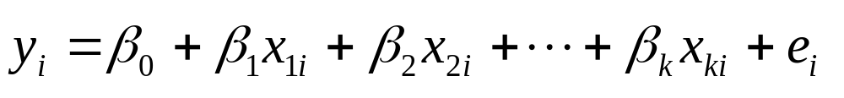
6.1 Introduction
In Chapter 4 the multiple linear regression model was presented as
Certain assumptions were made about how the errors e_{i} behaved. In this chapter we will check to see if those assumptions appear reasonable.
Checking Assumptions
Copyright © 2005 Brooks/Cole, a division of Thomson Learning, Inc.

Slide 3
6.2 Assumptions of the Multiple Linear Regression Model
We expect the average disturbance e_{i} to be zero so the regression line passes through the average value of Y.
The disturbances have constant variance σ_{e}².
The disturbances are normally distributed.
The disturbances are independent.
Checking Assumptions
Copyright © 2005 Brooks/Cole, a division of Thomson Learning, Inc.

Slide 4
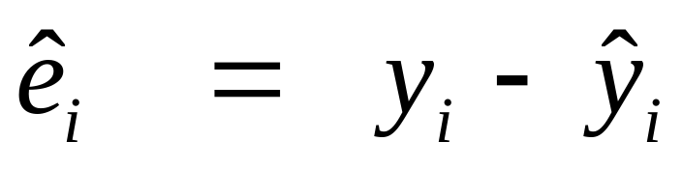
6.3 The Regression Residuals
We cannot check to see if the disturbances e_{i} behave correctly because they are unknown.
Instead, we work with their sample counterpart, the residuals
which represent the unexplained variation in the y values.
Checking Assumptions
Copyright © 2005 Brooks/Cole, a division of Thomson Learning, Inc.

Slide 5
Properties
Property 1: They will always average 0 because the least squares estimation procedure makes that happen.
Property 2: If assumptions a, b and d of Section 6.2 are true then the residuals should be randomly distributed around their mean of 0. There should be no systematic pattern in a residual plot.
Property 3: If assumptions a through d hold, the residuals should look like a random sample from a normal distribution.
Checking Assumptions
Copyright © 2005 Brooks/Cole, a division of Thomson Learning, Inc.

Slide 6
Suggested Residual Plots
Plot the residuals versus each explanatory variable.
Plot the residuals versus the predicted values.
For data collected over time or in any other sequence, plot the residuals in that sequence.
In addition, a histogram and box plot are useful for assessing normality.
Checking Assumptions
Copyright © 2005 Brooks/Cole, a division of Thomson Learning, Inc.

Slide 7
Standardized residuals
The residuals can be standardized by dividing by their standard error.
This will not change the pattern in a plot but will affect the vertical scale.
Standardized residuals are always scaled so that most are between -2 and +2 as in a standard normal distribution.
Checking Assumptions
Copyright © 2005 Brooks/Cole, a division of Thomson Learning, Inc.

Slide 8
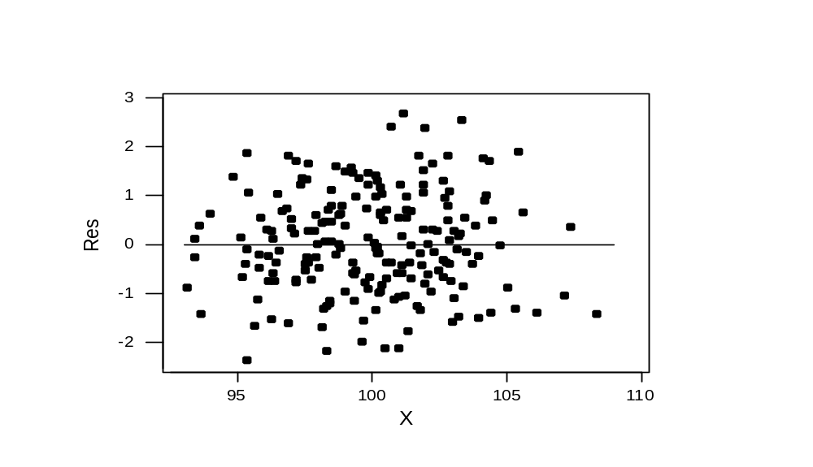
A plot meeting property 2
a. mean of 0 b. Same scatter d. No pattern with X
Checking Assumptions
Copyright © 2005 Brooks/Cole, a division of Thomson Learning, Inc.

Slide 9
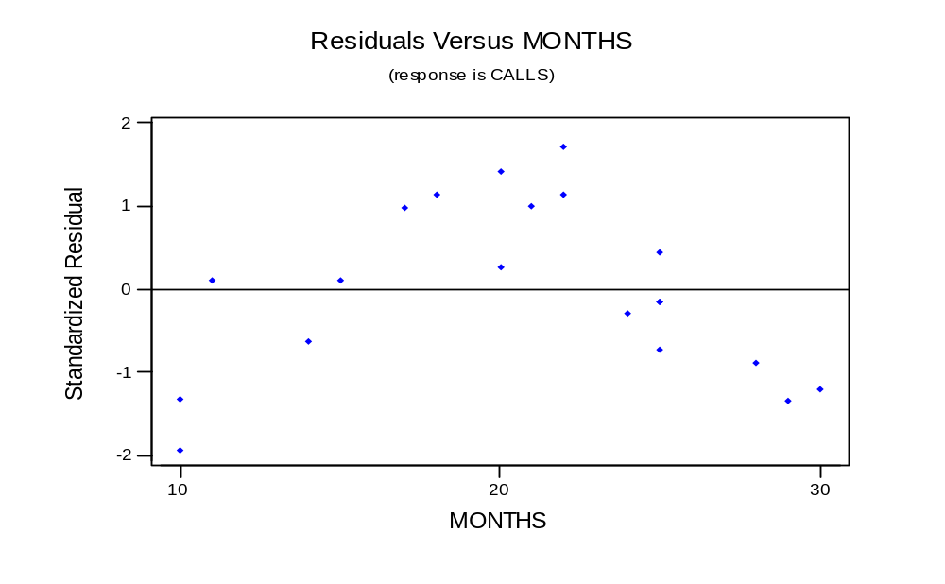
A plot showing a violation
Checking Assumptions
Copyright © 2005 Brooks/Cole, a division of Thomson Learning, Inc.

Slide 10
6.4 Checking Linearity
Although sometimes we can see evidence of nonlinearity in an X-Y scatterplot, in other cases we can only see it in a plot of the residuals versus X.
If the plot of the residuals versus an X shows any kind of pattern, it both shows a violation and a way to improve the model.
Checking Assumptions
Copyright © 2005 Brooks/Cole, a division of Thomson Learning, Inc.

Slide 11
Example 6.1: Telemarketing
n = 20 telemarketing employees
Y = average calls per day over 20 workdays
X = Months on the job
Data set TELEMARKET6
Checking Assumptions
Copyright © 2005 Brooks/Cole, a division of Thomson Learning, Inc.

Slide 12
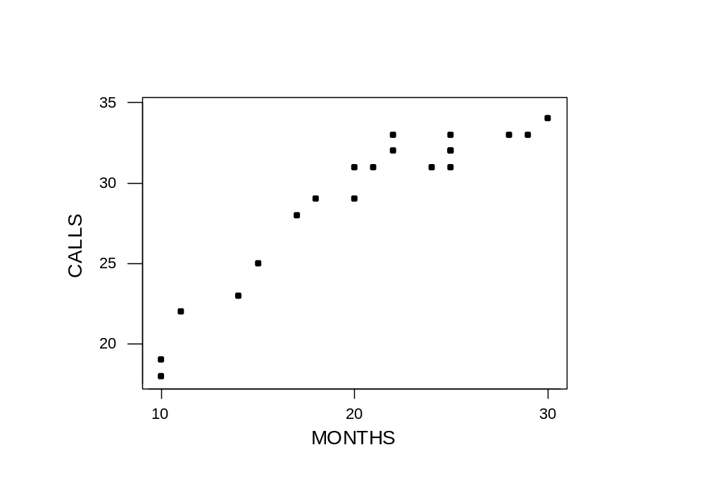
Plot of Calls versus Months
There is some curvature, but it is masked by the more obvious linearity.
Checking Assumptions
Copyright © 2005 Brooks/Cole, a division of Thomson Learning, Inc.

Slide 13
If you are not sure, fit the linear model and save the residuals
The regression equation is
CALLS = 13.7 + 0.744 MONTHS
Predictor Coef SE Coef T P
Constant 13.671 1.427 9.58 0.000
MONTHS 0.74351 0.06666 11.15 0.000
S = 1.787 R-Sq = 87.4% R-Sq(adj) = 86.7%
Analysis of Variance
Source DF SS MS F P
Regression 1 397.45 397.45 124.41 0.000
Residual Error 18 57.50 3.19
Total 19 454.95
Checking Assumptions
Copyright © 2005 Brooks/Cole, a division of Thomson Learning, Inc.

Slide 14
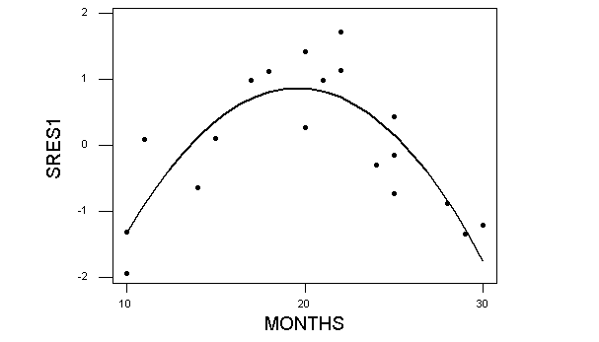
Residuals from model
With the linearity "taken out" the curvature is more obvious
Checking Assumptions
Copyright © 2005 Brooks/Cole, a division of Thomson Learning, Inc.

Slide 15
6.4.2 Tests for lack of fit
The residuals contain the variation in the sample of Y values that is not explained by the Yhat equation.
This variation can be attributed to many things, including:
  natural variation (random error)
  omitted explanatory variables
  incorrect form of model
Checking Assumptions
Copyright © 2005 Brooks/Cole, a division of Thomson Learning, Inc.

Slide 16
Lack of fit
If nonlinearity is suspected, there are tests available for lack of fit.
Minitab has two versions of this test, one requiring there to be repeated observations at the same X values.
These are on the Options submenu off the Regression menu
Checking Assumptions
Copyright © 2005 Brooks/Cole, a division of Thomson Learning, Inc.

Slide 17
The pure error lack of fit test
In the 20 observations for the telemarketing data, there are two at 10, 20 and 22 months, and four at 25 months.
These replicates allow the SSE to be decomposed into two portions, "pure error" and "lack of fit".
Checking Assumptions
Copyright © 2005 Brooks/Cole, a division of Thomson Learning, Inc.

Slide 18
The test
H₀: The relationship is linear
H_{a}: The relationship is not linear
The test statistic follows an F distribution with c – k – 1 numerator df and n – c denominator df
c = number of distinct levels of X
n = 20 and there were 6 replicates so c = 14
Checking Assumptions
Copyright © 2005 Brooks/Cole, a division of Thomson Learning, Inc.

Slide 19
Minitab's output
The regression equation is
CALLS = 13.7 + 0.744 MONTHS
Predictor Coef SE Coef T P
Constant 13.671 1.427 9.58 0.000
MONTHS 0.74351 0.06666 11.15 0.000
S = 1.787 R-Sq = 87.4% R-Sq(adj) = 86.7%
Analysis of Variance
Source DF SS MS F P
Regression 1 397.45 397.45 124.41 0.000
Residual Error 18 57.50 3.19
Lack of Fit 12 52.50 4.38 5.25 0.026
Pure Error 6 5.00 0.83
Total 19 454.95
Checking Assumptions
Copyright © 2005 Brooks/Cole, a division of Thomson Learning, Inc.

Slide 20
Test results
At a 5% level of significance, the critical value (from F_{12, 6} distribution) is 4.00.
The computed F is 5.25 is significant (p value of .026) so we conclude the relationship is not linear.
Checking Assumptions
Copyright © 2005 Brooks/Cole, a division of Thomson Learning, Inc.

Slide 21
Tests without replication
Minitab also has a series of lack of fit tests that can be applied when there is no replication.
When they are applied here, these messages appear:
The small p values suggest lack of fit.
Lack of fit test
Possible curvature in variable MONTHS (P-Value = 0.000)
Possible lack of fit at outer X-values (P-Value = 0.097)
Overall lack of fit test is significant at P = 0.000
Checking Assumptions
Copyright © 2005 Brooks/Cole, a division of Thomson Learning, Inc.

Slide 22
6.4.3 Corrections for nonlinearity
If the linearity assumption is violated, the appropriate correction is not always obvious.
Several alternative models were presented in Chapter 5.
In this case, it is not too hard to see that adding an X² term works well.
Checking Assumptions
Copyright © 2005 Brooks/Cole, a division of Thomson Learning, Inc.

Slide 23
Quadratic model
The regression equation is
CALLS = - 0.14 + 2.31 MONTHS - 0.0401 MonthSQ
Predictor Coef SE Coef T P
Constant -0.140 2.323 -0.06 0.952
MONTHS 2.3102 0.2501 9.24 0.000
MonthSQ -0.040118 0.006333 -6.33 0.000
S = 1.003 R-Sq = 96.2% R-Sq(adj) = 95.8%
Analysis of Variance
Source DF SS MS F P
Regression 2 437.84 218.92 217.50 0.000
Residual Error 17 17.11 1.01
Total 19 454.95
No evidence of lack of fit (P > 0.1)
Checking Assumptions
Copyright © 2005 Brooks/Cole, a division of Thomson Learning, Inc.

Slide 24
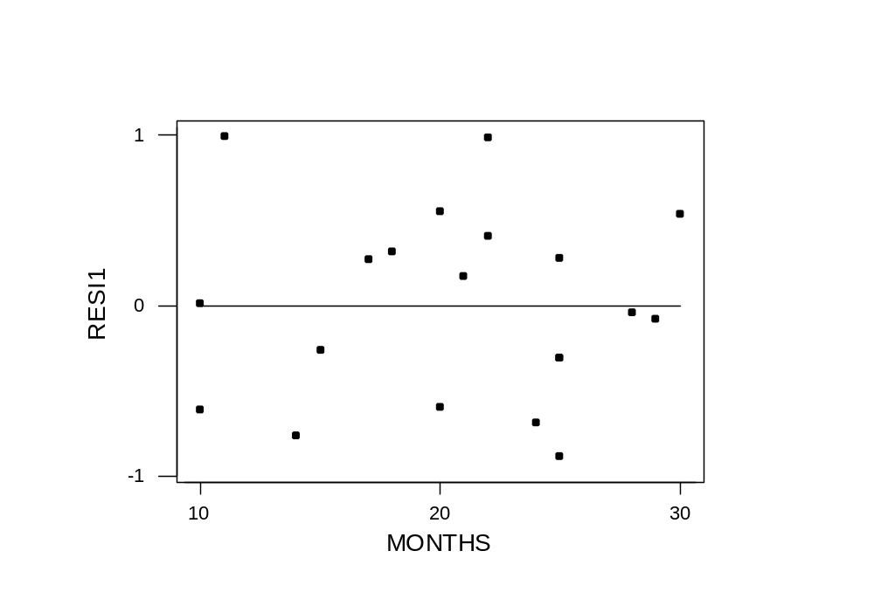
Residuals from quadratic model
No violations evident
Checking Assumptions
Copyright © 2005 Brooks/Cole, a division of Thomson Learning, Inc.

Slide 25
6.5 Check for constant variance
Assumption b states that the errors e_{i} should have the same variance everywhere.
This implies that if residuals are plotted against an explanatory variable, the scatter should be the same at each value of the X variable.
In economic data, however, it is fairly common to see that a variable that increases in value often will also increase in scatter.
Checking Assumptions
Copyright © 2005 Brooks/Cole, a division of Thomson Learning, Inc.

Slide 26
Example 6.3 FOC Sales
n = 265 months of sales data for a fibre-optic company
Y = Sales
X= Mon ( 1 thru 265)
Data set FOCSALES6
Checking Assumptions
Copyright © 2005 Brooks/Cole, a division of Thomson Learning, Inc.

Slide 27
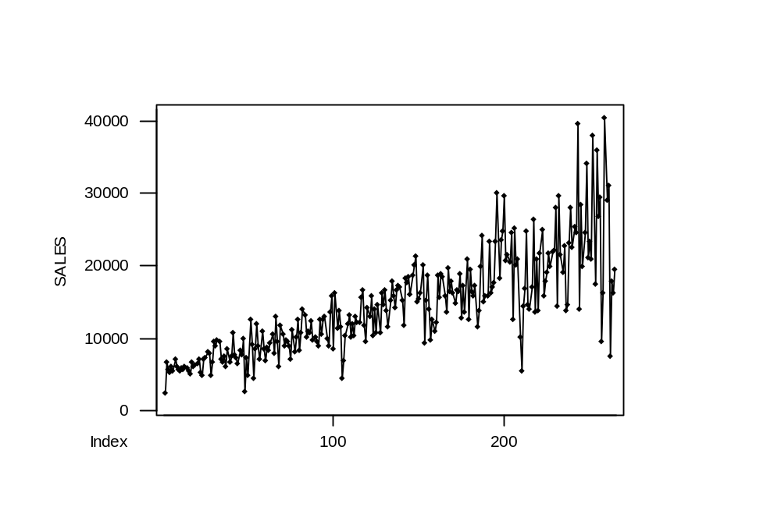
Data over time
Note: This uses Minitab’s Time Series Plot
Checking Assumptions
Copyright © 2005 Brooks/Cole, a division of Thomson Learning, Inc.

Slide 28
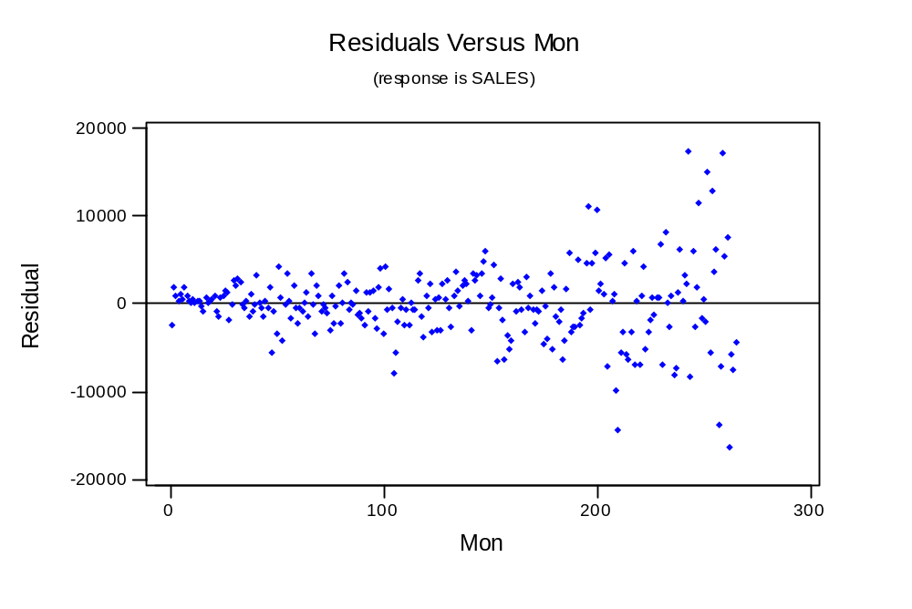
Residual plot
Checking Assumptions
Copyright © 2005 Brooks/Cole, a division of Thomson Learning, Inc.

Slide 29
Implications
When the errors e_{i} do not have a constant variance, the usual statistical properties of the least squares estimates may not hold.
In particular, the hypothesis tests on the model may provide misleading results.
Checking Assumptions
Copyright © 2005 Brooks/Cole, a division of Thomson Learning, Inc.

Slide 30
6.5.2 A Test for Nonconstant Variance
Szroeter developed a test that can be applied if the observations appear to increase in variance according to some sequence (often, over time).
To perform it, save the residuals, square them, then multiply by i (the observation number).
Details are in the text.
Checking Assumptions
Copyright © 2005 Brooks/Cole, a division of Thomson Learning, Inc.

Slide 31
6.5.3 Corrections for Nonconstant Variance
Several common approaches for correcting nonconstant variance are:
  Use ln(y) instead of y
  Use √y instead of y
  Use some other power of y, y^{p}, where the Box-Cox method is used to determine the value for p.
  Regress (y/x) on (1/x)
Checking Assumptions
Copyright © 2005 Brooks/Cole, a division of Thomson Learning, Inc.

Slide 32
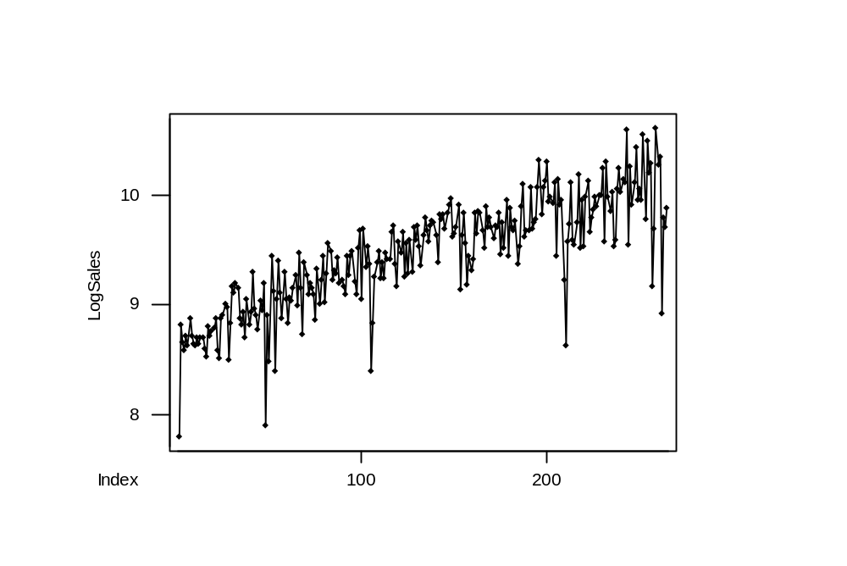
LogSales over time
Checking Assumptions
Copyright © 2005 Brooks/Cole, a division of Thomson Learning, Inc.

Slide 33
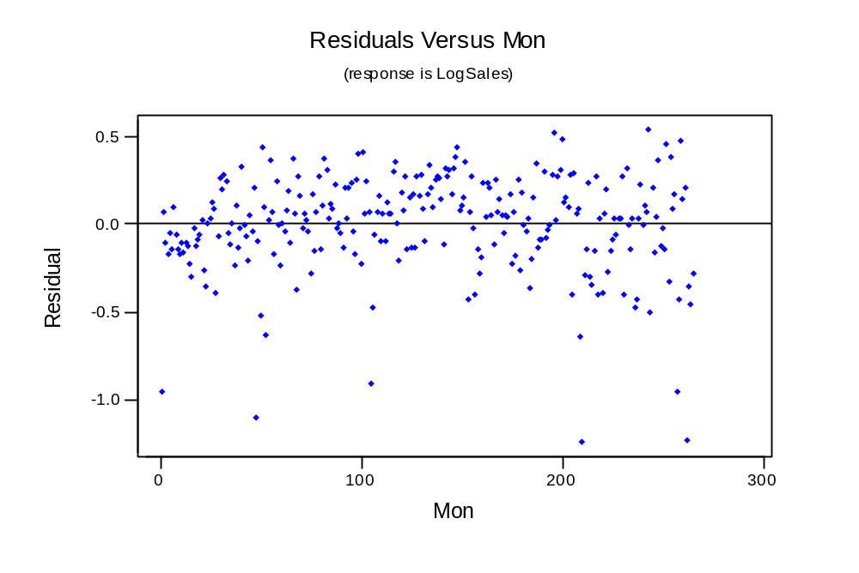
Residuals from Regression
This looks real good after I put this text box on top of those six large outliers.
Checking Assumptions
Copyright © 2005 Brooks/Cole, a division of Thomson Learning, Inc.

Slide 34
6.6 Assessing the Assumption That the Disturbances are Normally Distributed
There are many tools available to check the assumption that the disturbances are normally distributed.
If the assumption holds, the standardized residuals should behave like they came from a standard normal distribution.
  about 68% between -1 and +1
  about 95% between -2 and +2
  about 99% between -3 and +3
Checking Assumptions
Copyright © 2005 Brooks/Cole, a division of Thomson Learning, Inc.

Slide 35
6.6.1 Using Plots to Assess Normality
You can plot the standardized residuals versus fitted values and count how many are beyond -2 and +2; about 1 in 20 would be the usual case.
Minitab will do this for you if ask it to check for unusual observations (those flagged by an R have a standardized residual beyond ±2.
Checking Assumptions
Copyright © 2005 Brooks/Cole, a division of Thomson Learning, Inc.

Slide 36
Other tools
Use a Normal Probability plot to test for normality.
Use a histogram (perhaps with a superimposed normal curve) to look at shape.
Use a Boxplot for outlier detection. It will show all outliers with an *.
Checking Assumptions
Copyright © 2005 Brooks/Cole, a division of Thomson Learning, Inc.

Slide 37
Example 6.5 Communication Nodes
Data in COMNODE6
n = 14 communication networks
Y = Cost
X₁ = Number of ports
X₂ = Bandwidth
Checking Assumptions
Copyright © 2005 Brooks/Cole, a division of Thomson Learning, Inc.

Slide 38
Regression with unusuals flagged
The regression equation is
COST = 17086 + 469 NUMPORTS + 81.1 BANDWIDTH
Predictor Coef SE Coef T P
Constant 17086 1865 9.16 0.000
NUMPORTS 469.03 66.98 7.00 0.000
BANDWIDT 81.07 21.65 3.74 0.003
S = 2983 R-Sq = 95.0% R-Sq(adj) = 94.1%
Analysis of Variance
(deleted)
Unusual Observations
Obs NUMPORTS COST Fit SE Fit Residual St Resid
1 68.0 52388 53682 2532 -1294 -0.82 X
10 24.0 23444 29153 1273 -5709 -2.12R
R denotes an observation with a large standardized residual
X denotes an observation whose X value gives it large influence.
Checking Assumptions
Copyright © 2005 Brooks/Cole, a division of Thomson Learning, Inc.

Slide 39
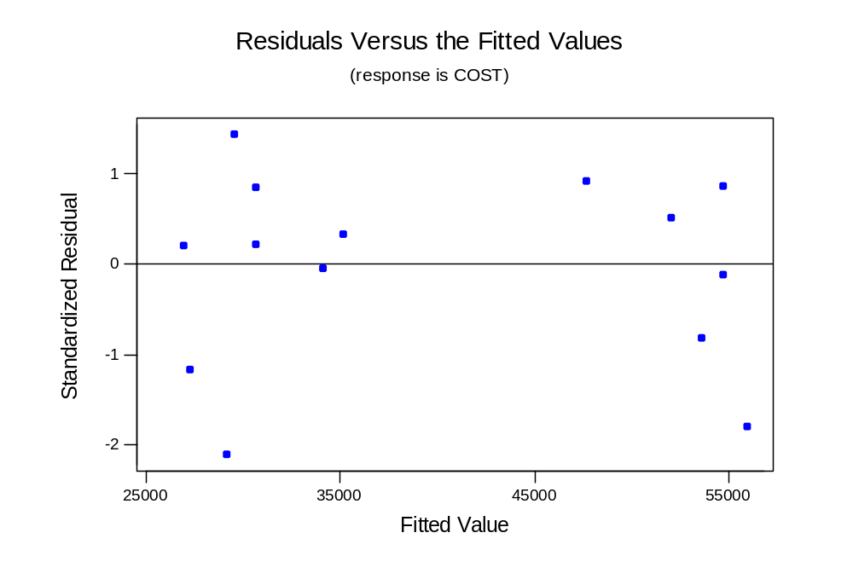
Residuals versus fits (from regression graphs)
Checking Assumptions
Copyright © 2005 Brooks/Cole, a division of Thomson Learning, Inc.

Slide 40
6.6.2 Tests for normality
There are several formal tests for the hypothesis that the disturbances e_{i} are normal versus nonnormal.
These are often accompanied by graphs* which are scaled so that data which are normally-distributed appear in a straight line.
* Your Minitab output may appear a little different depending on whether you have the student or professional version, and which release you have.
Checking Assumptions
Copyright © 2005 Brooks/Cole, a division of Thomson Learning, Inc.

Slide 41
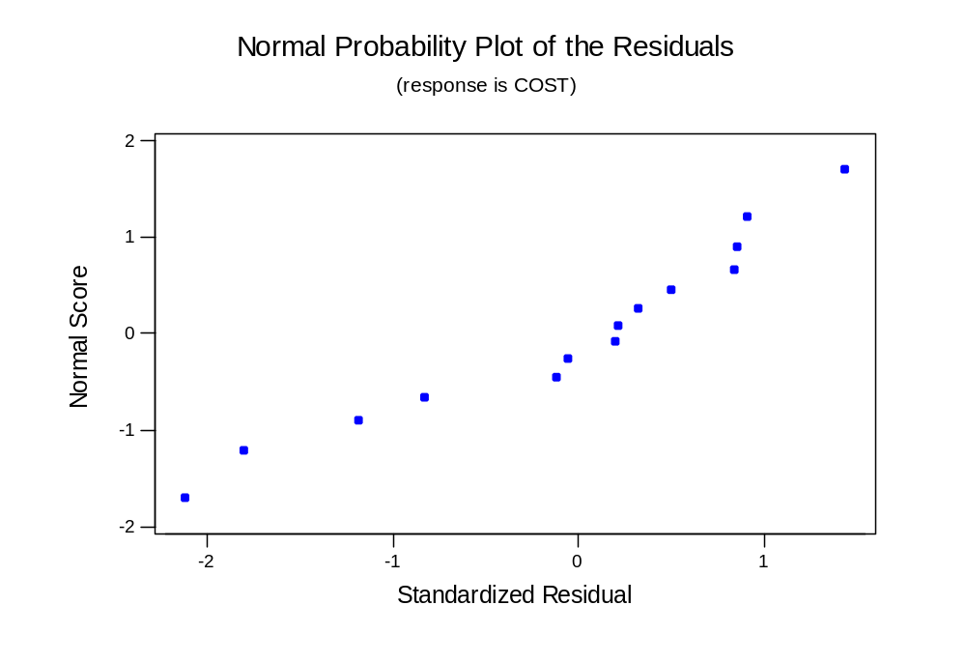
Normal plot (from regression graphs)
If normal, should follow straight line
Checking Assumptions
Copyright © 2005 Brooks/Cole, a division of Thomson Learning, Inc.

Slide 42
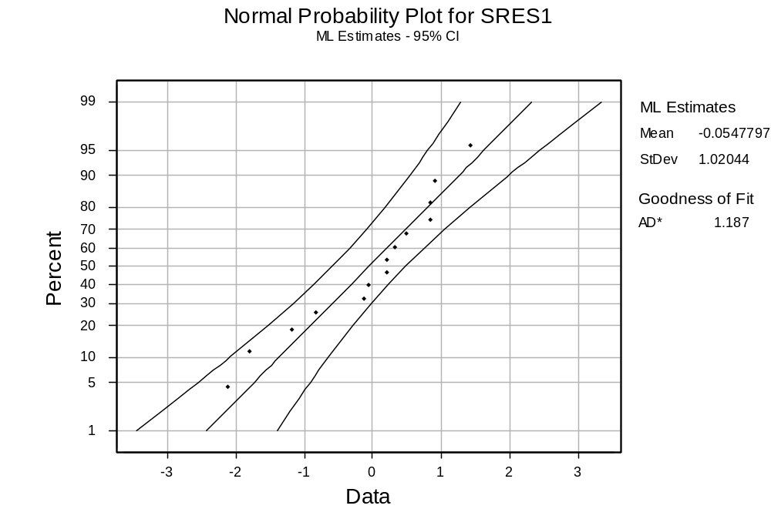
Normal probability plot (graph menu)
Checking Assumptions
Copyright © 2005 Brooks/Cole, a division of Thomson Learning, Inc.

Slide 43
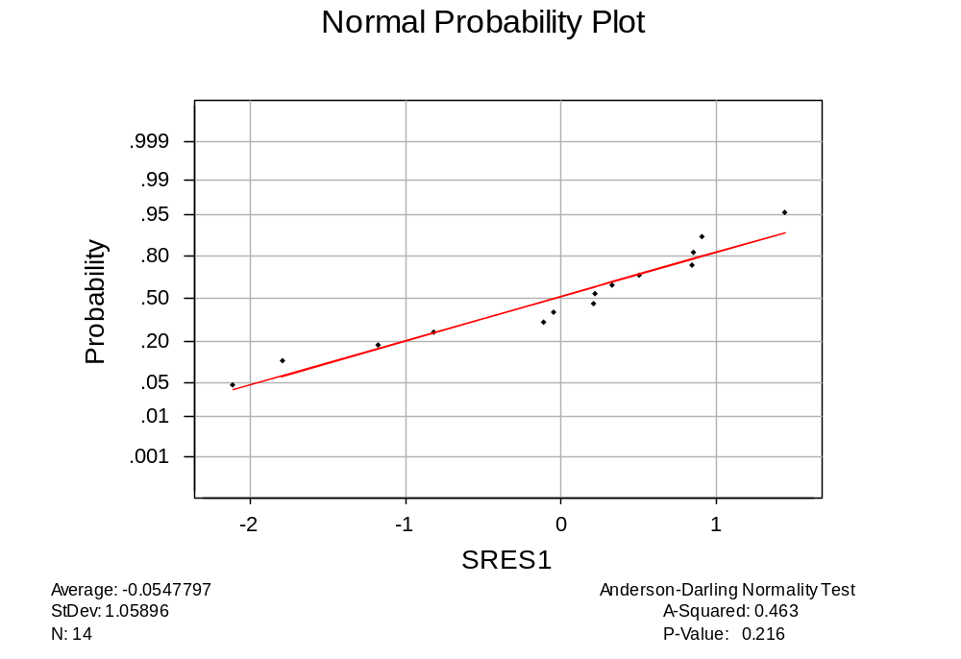
Test for Normality (Basic Statistics Menu)
Accepts
H_{o}: Normality
Checking Assumptions
Copyright © 2005 Brooks/Cole, a division of Thomson Learning, Inc.

Slide 44
Part 2
Checking Assumptions
Copyright © 2005 Brooks/Cole, a division of Thomson Learning, Inc.

Slide 45
Example 6.7 S&L Rate of Return
Data set SL6
n =35 Saving and Loans stocks
Y = rate of return for 5 years ending 1982
X₁ = the "Beta" of the stock
X₂ = the "Sigma" of the stock
Beta is a measure of nondiversifiable risk and Sigma a measure of total risk
Checking Assumptions
Copyright © 2005 Brooks/Cole, a division of Thomson Learning, Inc.

Slide 46
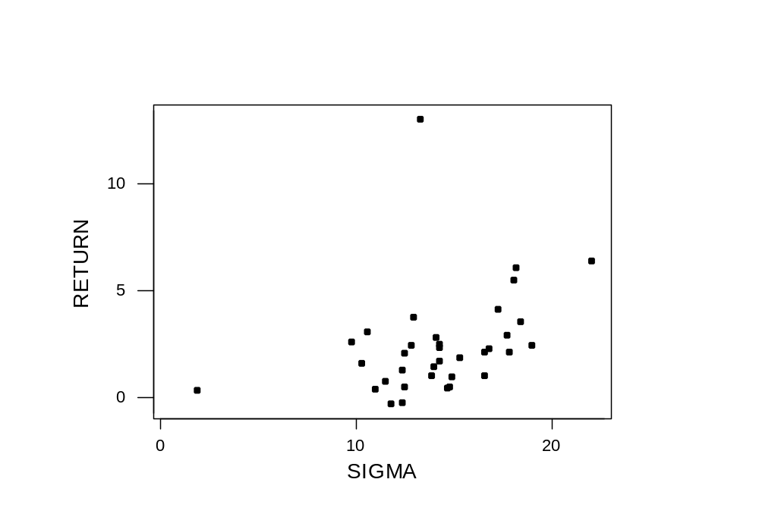
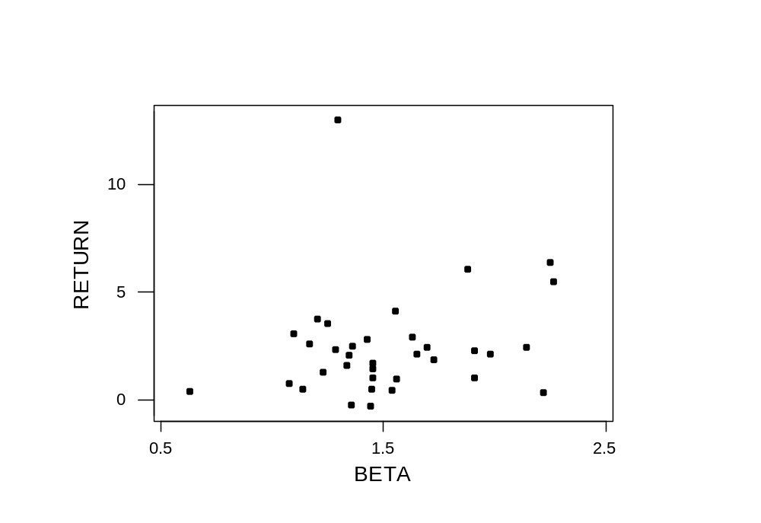
Basic exploration
Correlations: RETURN, BETA, SIGMA
RETURN BETA
BETA 0.180
SIGMA 0.351 0.406
Checking Assumptions
Copyright © 2005 Brooks/Cole, a division of Thomson Learning, Inc.

Slide 47
Not much explanatory power
The regression equation is
RETURN = - 1.33 + 0.30 BETA + 0.231 SIGMA
Predictor Coef SE Coef T P
Constant -1.330 2.012 -0.66 0.513
BETA 0.300 1.198 0.25 0.804
SIGMA 0.2307 0.1255 1.84 0.075
S = 2.377 R-Sq = 12.5% R-Sq(adj) = 7.0%
Analysis of Variance
(deleted)
Unusual Observations
Obs BETA RETURN Fit SE Fit Residual St Resid
19 2.22 0.300 -0.231 2.078 0.531 0.46 X
29 1.30 13.050 2.130 0.474 10.920 4.69R
R denotes an observation with a large standardized residual
X denotes an observation whose X value gives it large influence.
Checking Assumptions
Copyright © 2005 Brooks/Cole, a division of Thomson Learning, Inc.

Slide 48
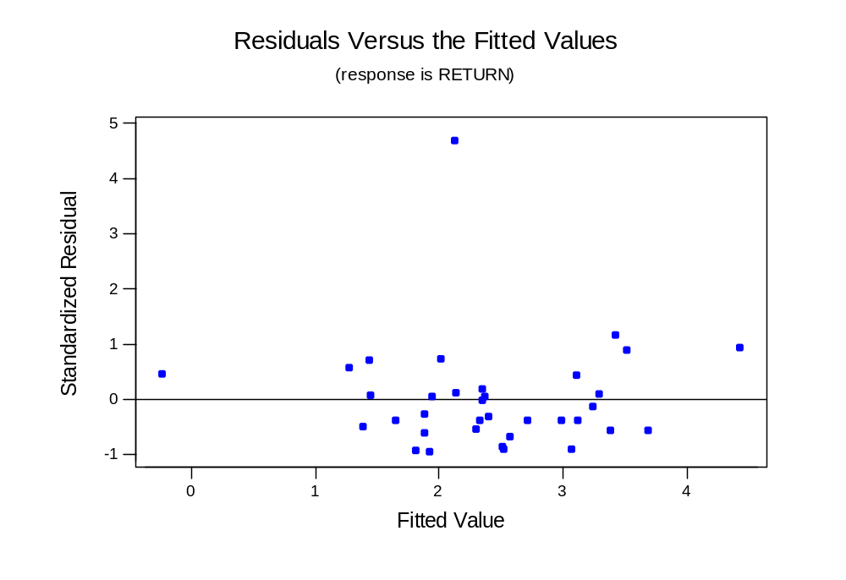
One in every crowd?
Checking Assumptions
Copyright © 2005 Brooks/Cole, a division of Thomson Learning, Inc.

Slide 49
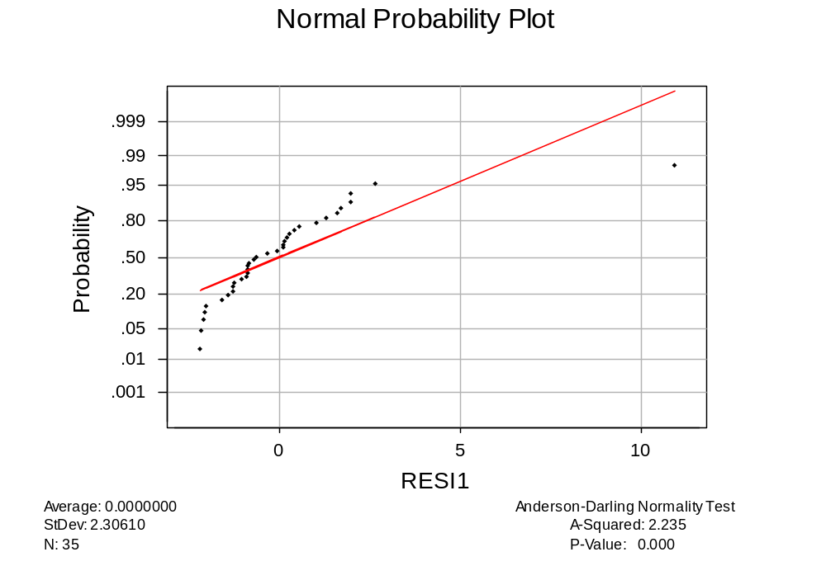
Normality Test
Reject
H₀: Normality
Checking Assumptions
Copyright © 2005 Brooks/Cole, a division of Thomson Learning, Inc.

Slide 50
6.6.3 Corrections for Nonnormality
Normality is not necessary for making inference with large samples.
It is required for inference with small samples.
The remedies are similar to those used to correct for nonconstant variance.
Checking Assumptions
Copyright © 2005 Brooks/Cole, a division of Thomson Learning, Inc.

Slide 51
6.7 Influential Observations
In minimizing SSE, the least squares procedure tries to avoid large residuals.
It thus "pays a lot of attention" to y values that don't fit the usual pattern in the data. Refer to the example in Figures 6.42(a) and 6.42(b).
That probably also happened in the S&L data where the one very high return masked the relationship between rate of return, beta and sigma for the other 34 stocks.
Checking Assumptions
Copyright © 2005 Brooks/Cole, a division of Thomson Learning, Inc.

Slide 52
6.7.2 Identifying outliers
Minitab flags any residual bigger than 2 in absolute value as a potential outlier.
A boxplot of the residuals uses a slightly different rule, but should give similar results.
There is also a third type of residual that is often used for this purpose.
Checking Assumptions
Copyright © 2005 Brooks/Cole, a division of Thomson Learning, Inc.

Slide 53
Deleted residuals
If you (temporarily) eliminate the i^{th} observation from the data set, it cannot influence the estimation process.
You can then compute a "deleted" residual to see if this point fits the pattern in the other observations.
Checking Assumptions
Copyright © 2005 Brooks/Cole, a division of Thomson Learning, Inc.

Slide 54
Deleted Residual Illustration
The regression equation is
ReturnWO29 = - 2.51 + 0.846 BETA + 0.232 SIGMA
34 cases used 1 cases contain missing values
Predictor Coef SE Coef T P
Constant -2.510 1.153 -2.18 0.037
BETA 0.8463 0.6843 1.24 0.225
SIGMA 0.23220 0.07135 3.25 0.003
S = 1.352 R-Sq = 37.2% R-Sq(adj) = 33.1%
Without observation 29, we get a much better fit.
Predicted Y₂₉ = -2.51 + .846(1.2973) + .232(13.3110) = 1.678
Prediction SE is 1.379
Deleted residual₂₉ = (13.05 – 1.678)/1.379 = 8.24
Checking Assumptions
Copyright © 2005 Brooks/Cole, a division of Thomson Learning, Inc.

Slide 55
The influence of observation 29
When it was temporarily removed, the R² went from 12.5% to 37.2% and we got a very different equation
The deleted residual for this observation was a whopping 8.24, which shows it had a lot of weight in determining the original equation.
Checking Assumptions
Copyright © 2005 Brooks/Cole, a division of Thomson Learning, Inc.

Slide 56
6.7.3 Identifying Leverage Points
Outliers have unusual y values; data points with unusual X values are said to have leverage. Minitab flags these with an X.
These points can have a lot of influence in determining the Yhat equation, particularly if they don't fit well. Minitab would flag these with both an R and an X.
Checking Assumptions
Copyright © 2005 Brooks/Cole, a division of Thomson Learning, Inc.

Slide 57
Leverage
The leverage of the i^{th} observation is h_{i} (it is hard to show where this comes from without matrix algebra).
If h > 2(K+1)/n it has high leverage.
For S&P returns, k = 2 and n = 35 so the benchmark is 2(3)/35 = .171
Observation 19 has a very small value for Sigma, this is the reason why it has h₁₉ = .764
Checking Assumptions
Copyright © 2005 Brooks/Cole, a division of Thomson Learning, Inc.

Slide 58
6.7.4 Combined Measures
The effect of an observation on the regression line is a function of both the y and X values.
Several statistics have been developed that attempt to measure combined influence.
The DFIT statistic and Cook's D are two more-popular measures.
Checking Assumptions
Copyright © 2005 Brooks/Cole, a division of Thomson Learning, Inc.

Slide 59
The DFIT statistic
The DFIT statistic is a function of both the residual and the leverage.
Minitab can compute and save these under "Storage".
Sometimes a cutoff is used, but it is perhaps best just to look for values that are high.
Checking Assumptions
Copyright © 2005 Brooks/Cole, a division of Thomson Learning, Inc.

Slide 60
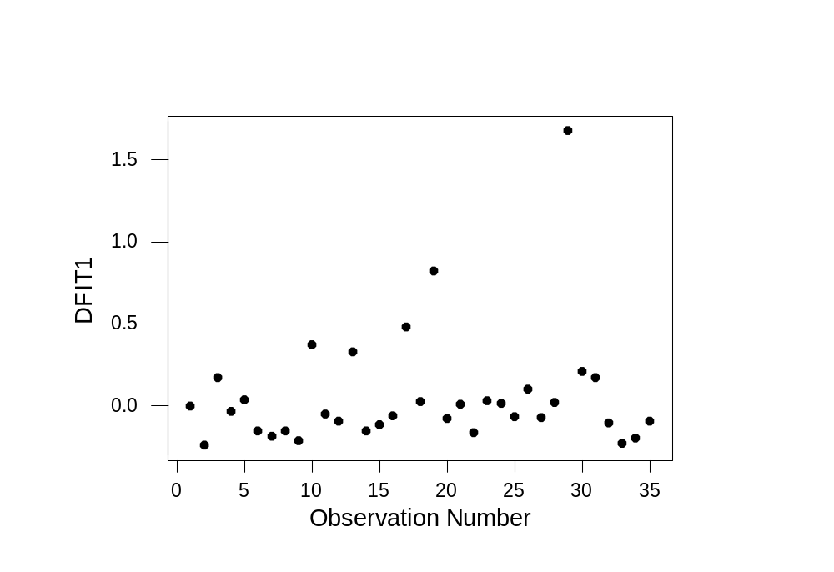
DFIT Graphed
29
19
Checking Assumptions
Copyright © 2005 Brooks/Cole, a division of Thomson Learning, Inc.

Slide 61
Cook's D
Often called Cook's Distance
Minitab also will compute these and store them.
Again, it might be best just to look for high values rather than use a cutoff.
Checking Assumptions
Copyright © 2005 Brooks/Cole, a division of Thomson Learning, Inc.

Slide 62
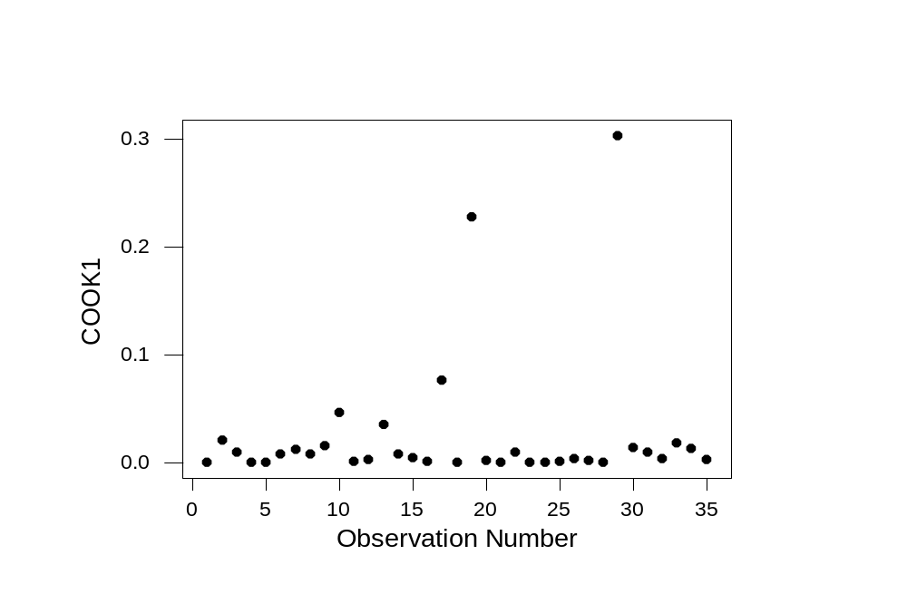
Cook's D Graphed
29
19
Checking Assumptions
Copyright © 2005 Brooks/Cole, a division of Thomson Learning, Inc.

Slide 63
6.7.5 What to do with Unusual Observations
Observation 19 (First Lincoln Financial Bank) has high influence because of its very low Sigma.
Observation 29 (Mercury Saving) had a very high return of 13.05 but its Beta and Sigma were not unusual.
Since both values are out of line with the other S&L banks, they may represent data recording errors.
Checking Assumptions
Copyright © 2005 Brooks/Cole, a division of Thomson Learning, Inc.

Slide 64
Eliminate? Adjust?
If you can do further research you might find out the true story.
You should eliminate an outlier data point only when you are convinced it does not belong with the others (for example, if Mercury was speculating wildly).
An alternative is to keep the data point but add an indicator variable to the model that signals there is something unusual about this observation.
Checking Assumptions
Copyright © 2005 Brooks/Cole, a division of Thomson Learning, Inc.

Slide 65
6.8 Assessing the Assumption That the Disturbances are Independent
If the disturbances are independent, the residuals should not display any patterns.
One such pattern was the curvature in the residuals from the linear model in the telemarketing example.
Another pattern occurs frequently in data collected over time.
Checking Assumptions
Copyright © 2005 Brooks/Cole, a division of Thomson Learning, Inc.

Slide 66
6.8.1 Autocorrelation
In time series data we often find that the disturbances tend to stay at the same level over consecutive observations.
If this feature, called autocorrelation, is present, all our model inferences may be misleading.
Checking Assumptions
Copyright © 2005 Brooks/Cole, a division of Thomson Learning, Inc.

Slide 67
First-order autocorrelation
If the disturbances have first-order autocorrelation, they behave as:
e_{i} = ρ e_{i-1} + µ_{i}
where µ_{i} is a disturbance with expected value 0 and independent over time.
Checking Assumptions
Copyright © 2005 Brooks/Cole, a division of Thomson Learning, Inc.

Slide 68
The effect of autocorrelation
If you knew that e₅₆ was 10 and ρ was .7, you would expect e₅₇ to be 7 instead of zero.
This dependence can lead to high standard errors for the b_{j} coefficients and wider confidence intervals.
Checking Assumptions
Copyright © 2005 Brooks/Cole, a division of Thomson Learning, Inc.

Slide 69
6.8.2 A Test for First-Order Autocorrelation
Durbin and Watson developed a test for positive autocorrelation of the form:
H₀: ρ = 0
H_{a}: ρ > 0
Their test statistic d is scaled so that it is 2 if no autocorrelation is present and near 0 if it is very strong.
Checking Assumptions
Copyright © 2005 Brooks/Cole, a division of Thomson Learning, Inc.

Slide 70
A Three-Part Decision Rule
The Durbin-Watson test distribution depends on n and K. The tables (Table B.7) list two decision points d_{L} and d_{U}.
If d < d_{L} reject H₀ and conclude there is positive autocorrelation.
If d > d_{U} accept H₀ and conclude there is no autocorrelation.
If d_{L} ≤ d ≤ d_{U} the test is inconclusive.
Checking Assumptions
Copyright © 2005 Brooks/Cole, a division of Thomson Learning, Inc.

Slide 71
Example 6.10 Sales and Advertising
n = 36 years of annual data
Y = Sales (in million $)
X = Advertising expenditures ($1000s)
Data in Table 6.6
Checking Assumptions
Copyright © 2005 Brooks/Cole, a division of Thomson Learning, Inc.

Slide 72
The Test
n = 36 and K = 1 X-variable
At a 5% level of significance, Table B.7 gives d_{L} = 1.41 and d_{U} = 1.52
Decision Rule:
  Reject H₀ if d < 1.41
  Accept H₀ if d > 1.52
  Inconclusive if 1.41 ≤ d ≤ 1.52
Checking Assumptions
Copyright © 2005 Brooks/Cole, a division of Thomson Learning, Inc.

Slide 73
Regression With DW Statistic
The regression equation is
Sales = - 633 + 0.177 Adv
Predictor Coef SE Coef T P
Constant -632.69 47.28 -13.38 0.000
Adv 0.177233 0.007045 25.16 0.000
S = 36.49 R-Sq = 94.9% R-Sq(adj) = 94.8%
Analysis of Variance
Source DF SS MS F P
Regression 1 842685 842685 632.81 0.000
Residual Error 34 45277 1332
Total 35 887961
Unusual Observations
Obs Adv Sales Fit SE Fit Residual St Resid
1 5317 381.00 309.62 11.22 71.38 2.06R
15 6272 376.10 478.86 6.65 -102.76 -2.86R
R denotes an observation with a large standardized residual
Durbin-Watson statistic = 0.47
Significant autocorrelation
Checking Assumptions
Copyright © 2005 Brooks/Cole, a division of Thomson Learning, Inc.

Slide 74
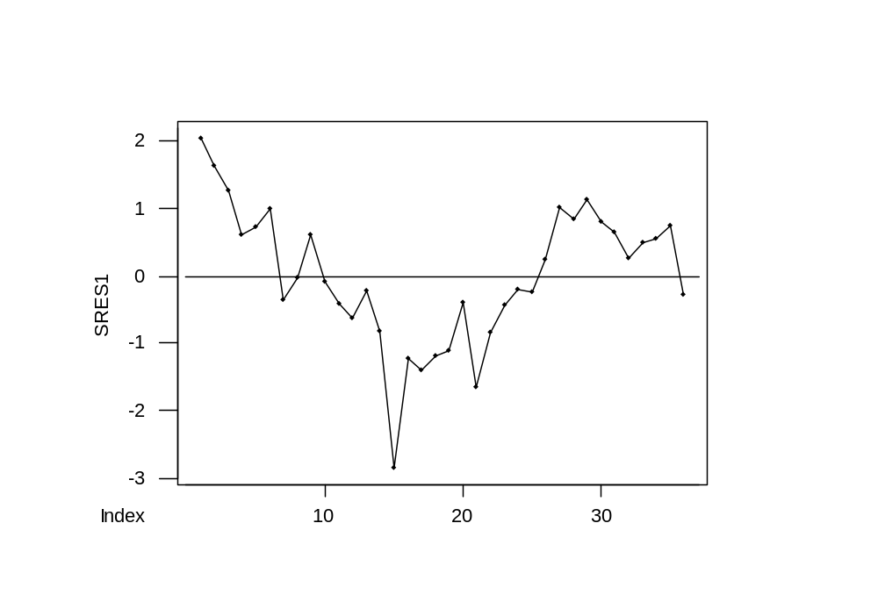
Plot of Residuals over Time
Shows first-order autocorrelation with r = .71
Checking Assumptions
Copyright © 2005 Brooks/Cole, a division of Thomson Learning, Inc.

Slide 75
6.8.3 Correction for First-Order Autocorrelation
One popular approach creates a new y and x variable.
First, obtain an estimate of ρ. Here we use r = .71 from Minitab's Autocorrelation analysis.
Then compute y_{i}* = y_{i} – r y_{i-1}
and x_{i}* = x_{i} – r x_{i-1}
Checking Assumptions
Copyright © 2005 Brooks/Cole, a division of Thomson Learning, Inc.

Slide 76
First Observation Missing
Because the transformation depends on lagged y and x values, the first observation requires special handling.
The text suggests y₁* = √1 – r² y₁
and a similar computation for x₁*
Checking Assumptions
Copyright © 2005 Brooks/Cole, a division of Thomson Learning, Inc.

Slide 77
Other Approaches
An alternative is to use an estimation technique (such as SAS's Autoreg procedure) that automatically adjusts for autocorrelation.
A third option is to include a lagged value of y as an explanatory variable. In this model, the DW test is no longer appropriate.
Checking Assumptions
Copyright © 2005 Brooks/Cole, a division of Thomson Learning, Inc.

Slide 78
Regression With Lagged Sales as a Predictor
The regression equation is
Sales = - 234 + 0.0631 Adv + 0.675 LagSales
35 cases used 1 cases contain missing values
Predictor Coef SE Coef T P
Constant -234.48 78.07 -3.00 0.005
Adv 0.06307 0.02023 3.12 0.004
LagSales 0.6751 0.1123 6.01 0.000
S = 24.12 R-Sq = 97.8% R-Sq(adj) = 97.7%
Analysis of Variance
(deleted)
Unusual Observations
Obs Adv Sales Fit SE Fit Residual St Resid
15 6272 376.10 456.24 5.54 -80.14 -3.41R
16 6383 454.60 422.02 12.95 32.58 1.60 X
21 6794 512.00 559.41 4.46 -47.41 -2.00R
R denotes an observation with a large standardized residual
X denotes an observation whose X value gives it large influence.
Checking Assumptions
Copyright © 2005 Brooks/Cole, a division of Thomson Learning, Inc.

Slide 79
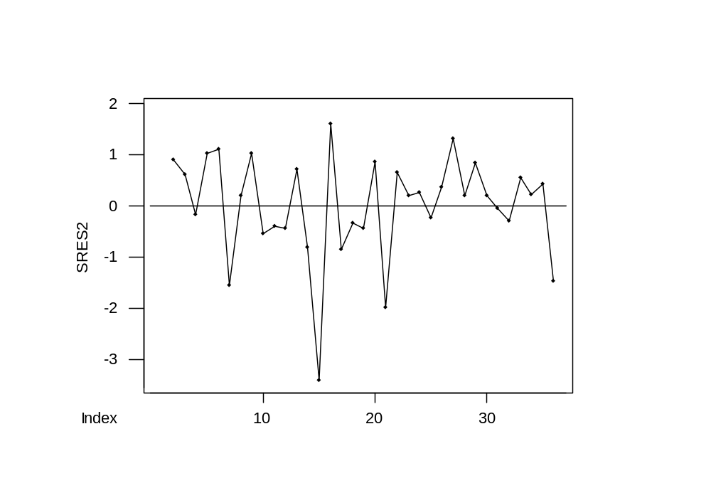
Residuals From Model With Lagged Sales
Now r = -.23 is not significant
Checking Assumptions
Copyright © 2005 Brooks/Cole, a division of Thomson Learning, Inc.

